Slide 1
Project Management using Sapient|Approach
Day 2
Version 1.4
Last Updated: 5 June, 2007

Slide 2
3 Day Agenda
DAY 1
DAY 2
DAY 3
S|A Overview
Estimate and plan a Fusion
Scope the project
Kick off the project
Execute the EAR
Prepare for the case study
Lunch
Scope the project (exercise)
Estimate and plan the project
Price the project
Plan and execute a release
Execute a Manage engagement
Common pitfalls and stories from the field
Execute the case study
Close and feedback
Notes:
Speaker notes:
Day 1 focuses on a Project Manager’s areas of responsibility prior to the project being sold.
Day 2 focuses on a Project Manager’s areas of responsibilitiy during project execution.
Day 3 provides the group with the opportunity to bring everything together and practice what they have learnt.

Slide 3

Day 2 Agenda
8:00 – 8:15 Kick-off
8:15 – 10:45 Set up and kick off a project
10:45 – 11:00 Break
11:00 – 1:00 Execute the EAR
1:00 – 2:00 Lunch
2:00 – 2:30 Execute the EAR (contd)
2:30 – 3:45 Plan and execute a release
3:45 – 4:00 Break
4:00 – 4:45 Execute a Manage engagement
4:45 – 5:30 Common pitfalls and stories from the field
5:30 – 6:00 Close and feedback
Notes:
Agenda for NA and EU

Slide 4
Day 2 Agenda
8:30 – 8:45 Kick-off
8:45 – 9:00 Pricing a project
9:00 – 10:30 Set up and kick off a project
10:30 – 1:00 Execute the EAR
1:00 – 1:30 Lunch
1:30 – 2:45 Plan and execute a release
2:45 – 3:00 Break
3:00 – 3:30 Execute a Manage engagement
3:30 – 4:30 Common pitfalls and stories from the field
4:00 – 5:00 Close and feedback
Notes:
Agenda for India (option 1)

Slide 5
Day 2 Agenda
9:00 – 9:15 Kick-off
9:15 – 9:30 Pricing a project
9:30 – 11:00 Set up and kick off a project
11:00 – 1:00 Execute the EAR
1:00 – 1:30 Lunch
1:30 – 2:00 Execute the EAR (contd)
2:00 – 3:15 Plan and execute a release
3:15 – 3:30 Break
3:30 – 4:00 Execute a Manage engagement
4:00 – 5:00 Common pitfalls and stories from the field
5:00 – 5:30 Close and feedback
Notes:
Agenda for India (option 1)

Slide 6


PM responsibilities related to delivering the “Product and Services”
Prep – preparing for the project
  Define the scope
  Drive the estimate
  Develop the project schedule
  Support development of the price
  others...
Set up and Kickoff – getting the project off the ground
  Drive definition of project vision and goals
  Work with staffing to staff the project
  Plan the project
  Set up ResultSpace
  Drive the project kick-off
  others...
Execute – running and wrapping up the delivery
  Plan iterations
  Track overall progress
  Drive iteration execution
  Drive iteration closure
  Manage issues and risks
  Manage changes to scope
  Ensure audits and project reviews are happening
  Monitor quality
  Ensure that the tools are in place and are being used correctly
  Ensure Sapient|Approach is being used correctly and consistently
  others...
** Red items will be covered today
Notes:
Speaker notes:
Note that this is only a subset, and there are many more
Also keep in mind, that many of these responsibilities are shared with the Arch (when it is a software project) eg monitor quality

Slide 7

Set up and kick off the project

Slide 8

Set up and kickoff – getting the project off the ground
PM activities
  Drive definition of project vision and goals
  Work with staffing to staff the project
  Set up the project team structure
  Plan the project (Release Plan, Iteration Plan, Communication Plan, etc)
  Set up ResultSpace
  Set up the S|A Adoption Plan
  Drive the project kick-off (Kick-off meeting, S|A Adoption Plan, etc)
  others...
You will have to answer the following questions:
  Has the project been estimated for success?
  Is the project staffed for success?
  Has the project been planned for success?
  How will the team be ramped up for success?
  Is the hardware and software procurement done?
  Are the basic processes and tools understood?
  Is the communication plan in place?
  Are the expectations of the individuals and team understood?
  Are the exit criteria for the current release documented and understood?
** Red items will be covered in this section
Notes:
Speaker notes:
Note that the PM here may be diff (hence the new “Plan” activity). Additionally, the initial plan may not go into as much detail as needed to actually execute the project.
Planning and setting up a project is not only about defining up the project schedule, it involves a much broader set of activities such as defining the roles and responsibilities, the training plan, hardware and software requirements, planning communication and so forth. Typically the high level project plan has been defined prior to the sale of the project.
Ask the participants: Why do you think it is important to do the rudimentary project planning and setup activities well when a project starts?
Answer: This is where we have seen projects go wrong at Sapient. If the project has not been started off on the right foot, it is extremely challenging for the PM and team to turn it around into a smoothely running project. You are then relying on heroics of team members, long hours etc for the project to be successful. The PM can mitigate this by thoroughly and diligently checking that all setup and planning activities have been effectively addressed, and hence gives the PM the chance to fix it or sound the alarm if there is a major issue.

Slide 9
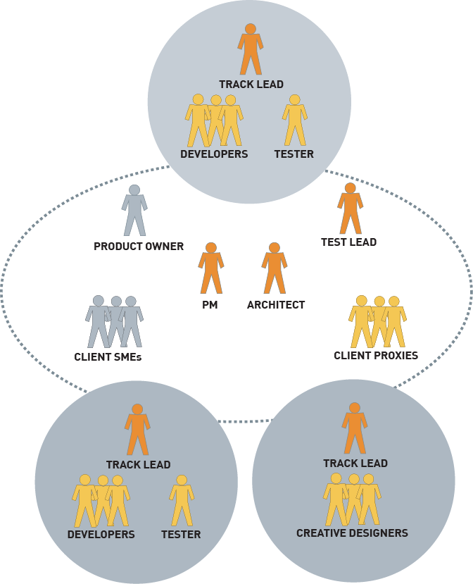



Set up the project team structure
A “virtual” team requires diligent communication of project information
Co-equal Project Manager and Architect roles
  PM owns schedule and budget
  Architect owns solution quality and architectural integrity
Decision making is decentralized into tracks
  Tracks are defined by function (not by skill set)
  Tracks are semi-autonomous units tasked with achieving specific objectives
  Typically a track will consist of 3-8 team members
Testing/QA functions are embedded into each track
Creative Design team usually has its own track
Legend:
Notes:
Speaker notes:
Key messages:
Arch and PM share ownership (see below for more details)
One product owner from the client side who participates in iteration checkpoints, and is accountable for the iteration and project scope decisions
Self managed tracks
Note that a typical track size is 4 – 10.
Tracks should be structured around functionality, NOT domain (as has been the case in the past)
Each track has a combination of developer and tester
Creative Designers will typically have their own track (for tracking purposed), however operationally CD track members will work across tracks.
Try and avoid distributed tracks ie avoid a track split across multiple geographies
Ask the participants what the see as the difference between PM and an Arch
High level: PM owns schedule and budget, Arch owns quality
More details:
PM: scope matrix, client relationship with product owner, team management, overall tracking, risk and issue management,
Architect: estimate, technical solution, testing quality, builds and releases, technical component of configuration management
Side note:
Point out that the client proxy is a role played by a Sapient person at the client site in addition to their assigned project role. It is not given to a person who is playing the client proxy role and nothing else.

Slide 10
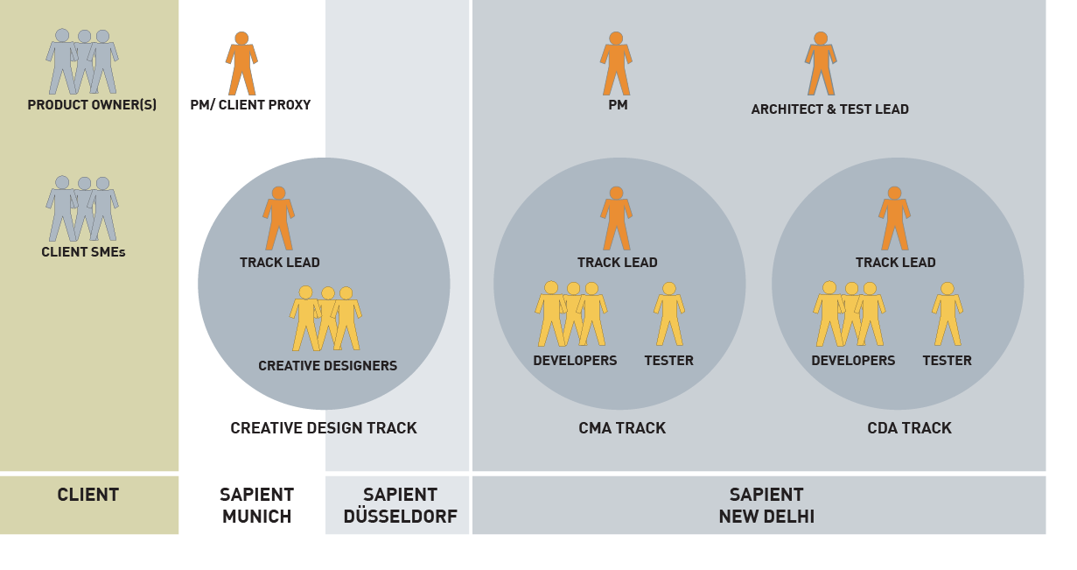
Project team structure – A real-life example
Notes:
Speaker notes:
Things to point out:
Multiple locations involved
Multiple product owners as opposed to one
Client Geography Sapient team is split across multiple geographies
Arch played the Test Lead role – which caused major problems

Slide 11
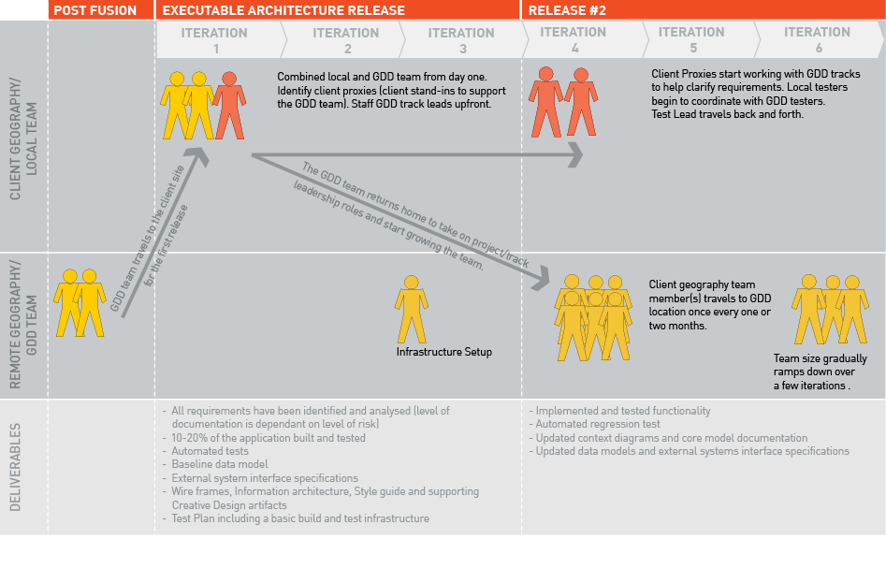
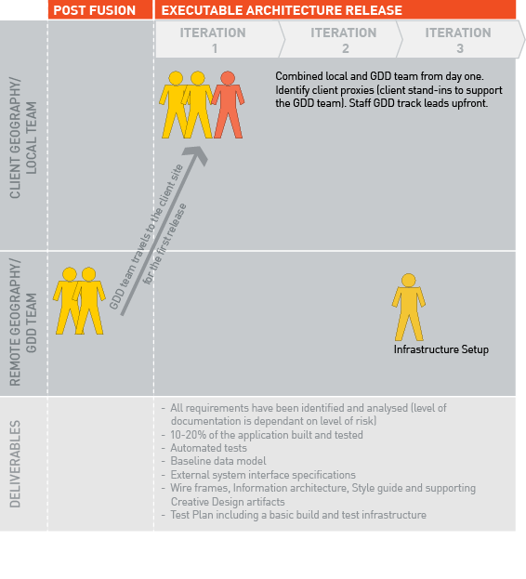
Distributed delivery
Notes:
Speaker notes:
This slide builds.
Key messages
The first few iterations are based at the client geography (including key team members from India)
They then travel back to India and the local people stay at the client geography
Note that the client leadership needs to travel to India once a month or so.

Slide 12
Define the Release Plan
_{EAR}
Finalise start dates and iteration length
Assign stories to iterations
Front-load higher value and higher risk stories
Use dependencies to sequence stories
Purpose is to define an initial state NOT to define absolute plan for future iterations – change is expected
  Only definite plan is initial iteration
  Based on learning from Iteration 1, set of stories planned for Iteration 2 will be modified
Added speaking points
_{Iteration 1}
_{Iteration 2}
_{Iteration 3}
Track A:
Story [4]
Story [4]
Story [5]
Story [3]
Story [4]
Story [3]
Story [5]
Story [5]
Track B:
Story [2]
Story
Story
Story [2]
Story
Story
Story [1]
Story
Story
Legend:
Dependancy
[N]
Story points
Notes:
Speaker notes:
Key message: The plan WILL change. The PM will do an initial cut at the release plan, but be fully aware and set expectations that the plan will change. For this reason, the level of planning is kept at the story level, and not at the micro or task level.
The only plan that should not an cannot change is the Iteration 1 plan, once it has been closed on with the client.
It‘s critical to understand what (if any) dependencies there are between creative and development tracks. The creative track should always be working AT LEAST 2 iterations ahead of the development track.
In the EAR and early releases the developement team and creative team should be checkpointing frequently to validate concepts, use cases, process flows, site maps and all other creative artefacts – The development team should be able to generate CTVs (Crappy Text Versions) from these checkpoints, and not expect perfectly specified wire frames from the creative track

Slide 13
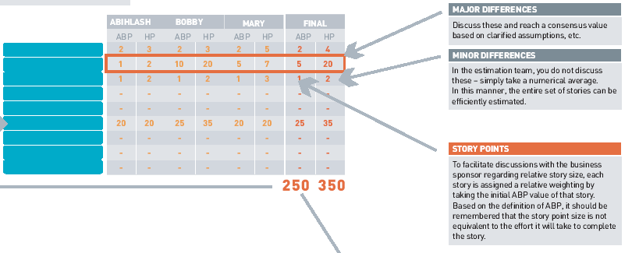
Story Points and Velocity
Story Points:
Represent the size of the story
Are used to facilitate discussions with the business sponsor regarding the amount of work that can be done in an iteration
The value is assigned by taking the ABP value of that story from the estimate
Expected Velocity:
The total number of story points to be achieved in an iteration
Automatically calculated in the Plan tool by allocating the total story points across iterations and adjusting it based on the staffing plan
Notes:
Speaker notes:
Key message: Story points are a way to measure how big the story is. It is not the same as LOE. The value is taken directly from the ABP (I will be able to hit this estimate 50% of the time).
Story points are not the story LOE because they are designed to detach people from the estimate. Murphy’s law says that if I put out an LOE for my work, I will finish my work in the time allocated (regardless of if too much time is allocated).
Similarly as time progresses, if the team constantly misses the targets, this is a good chance that the estimates were not correct, and then simply targeting less story points is more intuitive that striving for less LOE.

Slide 14
Load balance the Release Plan
_{EAR}
_{Iteration 1}
_{Iteration 2}
_{Iteration 3}
Expected velocity:
(automatically calculated)
8
12
12
= 32
Story [4]
Story [5]
Story [3]
Story [4]
Story [3]
Story [5]
Story [4]
Story [4]
Planned story points:
7
12
13
= 32
Legend:
Dependency
[N]
Story points
Notes:
Speaker notes:
The expected velocity is automatically calculated for each iteration when the stories have been entered and the staffing plan has been updated.
When assigning stories to iterations, the planned story points must equal the expected velocity.
In the example above, the planned stories assigned to each iteration also take into consideration the ramp-up required for the first iteration.
IMPORTANT NOTE:
The RS Plan Tool does not automatically calculate the expected velocity at the track level. So a manual step is required to calculate the available capacity for each track and allocate stories based on the capacity available.

Slide 15
Kickoff the project
Kicking off the project/release has 2 major goals:
  Ensure the team is ramped up (via the team Kick-off, training)
  Set up the S|A Adoption Plan
Example EAR Kick-off Agenda
1. Kick-off (purpose, objectives, agenda) 10 min
2. Introductions 10 – 20 min
3. Project/client background (purpose, vision, drivers, key clients etc) 30 min
4. Scope walkthrough 30-60 min
TEAM LUNCH
5. Project Plan walkthrough (HLP, Release Plan, Iteration 1 Plan) 30-60 min
6. Project structure 15 min
7. Tools and templates demo 30 min
8. Roles and responsibilities 30 min
9. Communication plan 15 min
10. Team building exercise 60-90 min
11. Next steps 10 min
12. Feedback 5 min
Notes:
Speaker notes:
Mention how critical a kick-off is to setting up the project on the right foot. And often when timelines are crunched, this is one of the first things PMs cut out. The end result is that the team is not on the same page, and although it may save time at the beginning, it costs time later.
Note that this is only an example agenda that should be tailored to meet the individual needs of the project.

Slide 16
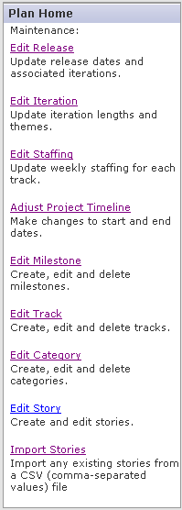
Set up the project in ResultSpace
ResultSpace Plan Tool
  Tool used to manage and track the project
  Detailed instructions on how to set it up can be found in the ResultSpace Help project
Why use the Plan Tool?
  It is custom built to support Sapient|Approach
  It is one of the primary repositories used to gather company metrics that will ultimately improve predicability
DEMO!
Notes:
Speaker notes:
Demo:
Show the participants where to find the Help project and where the links to the Plan tool setup instructions are (see below for link)
Click on Projects > All Projects > Select Help Project from the list
Talk briefly through the main features of RS (Trackers, Tasks, Wiki, etc)
For more info on what these things can be used for, read the “Introduction to ResultSpace” pres on the S|A site under Sales and Marketing> client presentations.
Demo the “Project Plan” Wiki that exists in the Example project. This is used to pull all pieces of a project together and must be set up for each project. (https://resultspace2.sapient.com/sf/wiki/do/viewPage/projects.example_project/wiki/HomePage)
For details on how to set up the Plan tool, select the the ResultSpace Help Project in the top nav and then go to the Sapient|Approach Plan Tool header. There are several links under that, specifically Project Setup, and Importing Stories.
https://resultspace2.sapient.com/sf/projects/help

Slide 17


Class Exercise #4
Setting up the project
Instructions (Total time required 90 min)
Split into groups of 2
Set up the project in ResultSpace including the following:
    Create the Project Workbook using the Wiki
    Set up the ResultSpace Plan tool
    Import stories into backlog
    Create the Release Plan
Share your results (15 min)
Notes:
Speaker notes:
Give participants the handout with further guidance on how to set their project up in RS. See Facilitation notes for details on how to facilitate this session.

Slide 18
Key Takeaways
Before the project can be set up in the Plan Tool, the core components must be defined, such as the high level release plan, team structure, etc
The purpose of the Release Plan is to define an initial state not to define an absolute plan for future iterations
While tools enable a project to function more effectively, they do not replace “the team thinking through what needs to happen” to successfully deliver the project

Slide 19
Execute the EAR

Slide 20
Execution – Running the delivery
PM activities
  Plan iterations
  Track overall progress
  Drive iteration execution
  Drive iteration closure
  Manage issues and risks
  Manage changes to scope
  Ensure audits and project reviews are happening
  Monitor quality
  Ensure that the tools are in place and are being used correctly
  Ensure Sapient|Approach is being used correctly and consistently
  others...
You will have to answer the following questions
  What stories will be included this iteration?
  What are the key issues and risks? Are they being addressed adequately?
  Are there any roadblocks preventing progress?
  Is the project on track for this iteration and overall?
  Are we managing scope changes effectively?
  Is the quality of the project as it should be?
  Others…
** Red items will be covered in this section
Notes:
Speaker notes:

Slide 21
EAR overview
Sapient|Approach
Fusion
Exec. Architecture Release
Release 2
Release 3
Manage
It 1
It 2
It 3
It 4
It 5
It 6
It 7
It 8
It 9
It 10
It 11
It 12
Iteration N
Go Live
Kick
off
Client team: acts as interface to client, does some dev work
GDD Team: develops and tests
Check
point
EAR is the initial release for a project where:
  Requirements (use cases) are documented at varying degrees of detail depending on risk and complexity
  Mandatory EAR artifacts are created (eg Logical and Physical Architecture, Database model, Interface specifications, Use case details, Object models, Wireframes and screen mockups)
  10-20% of the application is built and tested
  Stories are prioritised by technical risk and business value
For a FT/FP engagement, minimum amount of work is done during the EAR to be able to provide a solution and determine a FT/FP for the remainder of the project
Notes:
Speaker notes:
Point out the mandatory artifacts for the EAR.
Executable Architecture Release (EAR)
The purpose of the EAR is to do the minimum amount of work to understand the problem and commit to a solution
To achieve this each team must assess what combination of requirements, analysis, development and design activities are necessary to mitigate both requirement and technical risks associated with the project
Release Planning
Work with client to identify target functionality for first release: what is their “minimal marketable feature set?”
The smallest subset of the solution’s capabilities that would have value for the client
Know that the mid-level plan will change, don’t try to get too precise
Iteration Planning
An iteration length is 4 weeks
Focus on “Done is Done” while talking about iteration planning
Deliverables must be production-ready at end of every iteration
No separate “clean up” phase
Forces decision making and closure on the things of immediate concern
Need to leave time to do closeout within the iteration

Slide 22



Execute an iteration
Sapient|Approach
Fusion
Exec. Architecture Release
Release 2
Release 3
Manage
It 1
It 2
It 3
It 4
It 5
It 6
It 7
It 8
It 9
It 10
It 11
It 12
Go Live
Iteration N (1 – 4 weeks)
KICKOFF PREP
Work with the Arch (and Track Leads) to prepare for the iteration kickoff meeting with the client and the initial plan
Typically done prior to completion of the previous iteration
KICKOFF
Facilitate the kickoff meeting on day 1 of the iteration **
Guide the client in selecting stories
Facilitate gathering of detailed requirements for each story
Ensure tests are defined for each story
Ensure tasks are defined for each story
EXECUTE
Work with track leads to drive story execution and quality
Ensure only a handful of stories are being executed at a time
Facilitate client and team communication
Manage scope
Drive issue and risk management
CHECKPOINT
Facilitate checkpoint meeting with the client on last day of the iteration **
Communicate status (did we hit or miss our target)
Ensure client does hands-on testing of the stories
Gather feedback for next iteration
PM
PM
ARCH/CREATIVE LEAD
PM
PRODUCT
OWNER
TEAM
PM
ARCH/CRTV LEAD
TEAM
PM
PRODUCT
OWNER
TEAM
Adjusted roles, added speaker notes
** The kickoff and checkpoint may be combined into one meeting
Notes:
Speaker notes:
Key point: The end of iteration checkpoint and the iteration kickoff may be combined into 1 meeting!! This is absolutely fine and may often be the case because the client is only avail for 1 day per iteration, not 2 full days. However, note that the iteration planning needs to happen before these meetings to make sure that a proposed iteration plan is in place.
Key message about iteration planning: before walking the client through the proposed iteration plan, the PM and Arch/Creative Lead need to prep for that meeting. This needs to happen BEFORE the kickoff, and hence planning for the next iteration (by the PM and Arch) will need to happen at the end of this iteration. Remember planning for this meeting involves not only coming up with the iteration plan, but also planning the actual client meeting using standard facilitation technique and preparation. The client must also be guided along the way in order to get the most out of the project and for each iteration.
Similarly for the iteration checkpoint at the end of the iteration, the PM must be able to effectively communicate the status, not only when the team hits the target, but when they do not. The creative track and development track need to be continually checkpointing throughout the iteration

Slide 23
Manage scope
Sapient|Approach
Fusion
Exec. Architecture Release
Release 2
Release 3
Manage
It 1
It 2
It 3
It 4
It 5
It 6
It 7
It 8
It 9
It 10
It 11
It 12
Go Live
Iteration N (1 – 4 weeks)
KICKOFF PREP
Identify/validate targeted story points and stories (scope) planned for the iteration
KICKOFF
Work with client to finalise scope (stories and low level requirements) for the iteration
Stories can be swapped in and out, but total planned story points must not exceed targeted
EXECUTE
Scope for the iteration is fixed
Manage agreed upon scope very strictly
If new scope is identified, execute change request process and add story to the backlog (once change is approved)
CHECKPOINT
Review what was delivered with client
If client requests changes as a result of the team misunderstanding, Sapient must absorb the impact
PM
PM
ARCH
PM
PRODUCT
OWNER
TEAM
PM
ARCH
TEAM
PM
PRODUCT
OWNER
TEAM
Fixed scope
for the
iteration
What was
delivered
Updated Backlog
Updated
Backlog
Notes:
Speaker notes:
Key message: Once stories have been decided upon during the iteration kickoff, scope must be managed very tightly. Any new features or functionality that has an impact on the project schedule must be treated as a CR.
If a story is dropped out of scope completely, and a new story is swapped instead:
Strict contractual model
CR process starts
Scope bank is used to track stories added and removed
In plan tool, add story to backlog, and mark story removed as „dropped“
Agile model
In plan tool the new story is added to backlog, and story removed is marked as „dropped“
Compare this to a scenario of „project scope is to deliver 2 pens“
Our design is a blue pen and a black pen. But client wants to change it to 2 black pens
In a strict contratual model
a CR process would be involved
the Scope Bank would be updated, and
potentially the black pen story added to the backlog, and the blue pen story marked as „dropped“
In a more agile model, where the team is operating in a more fluid environment,
Only the Plan tool would be updated to reflect the new „Black pen“ story, and the „Blue pen“ story would be marked as „dropped“

Slide 24
Scope change request process
Client requests
scope change
Has Scope Matrix been baselined?
No
Agree upon changes with client and update the Scope Matrix
Change request (CR) process is required once the Scope Matrix has been baselined.
Triggered when the client requests additional scope that has previously not been planned for, and that has an impact on the overall project cost or schedule
Yes
Create Change Request (CR)
In CR Tracker
Review
CR with client
and CCB
Rework and resubmit
Reject
Conduct
Impact assessment
Review
impact
assessment
Rework and resubmit
Reject
Update Scope Matrix
and rebaseline
Implement change
Including adding new stories
to backlog if needed
Notes:
Speaker notes:
Key point to note is that once a CR has been approved, the scope matrix should be updated and if applicable new stories created.

Slide 25
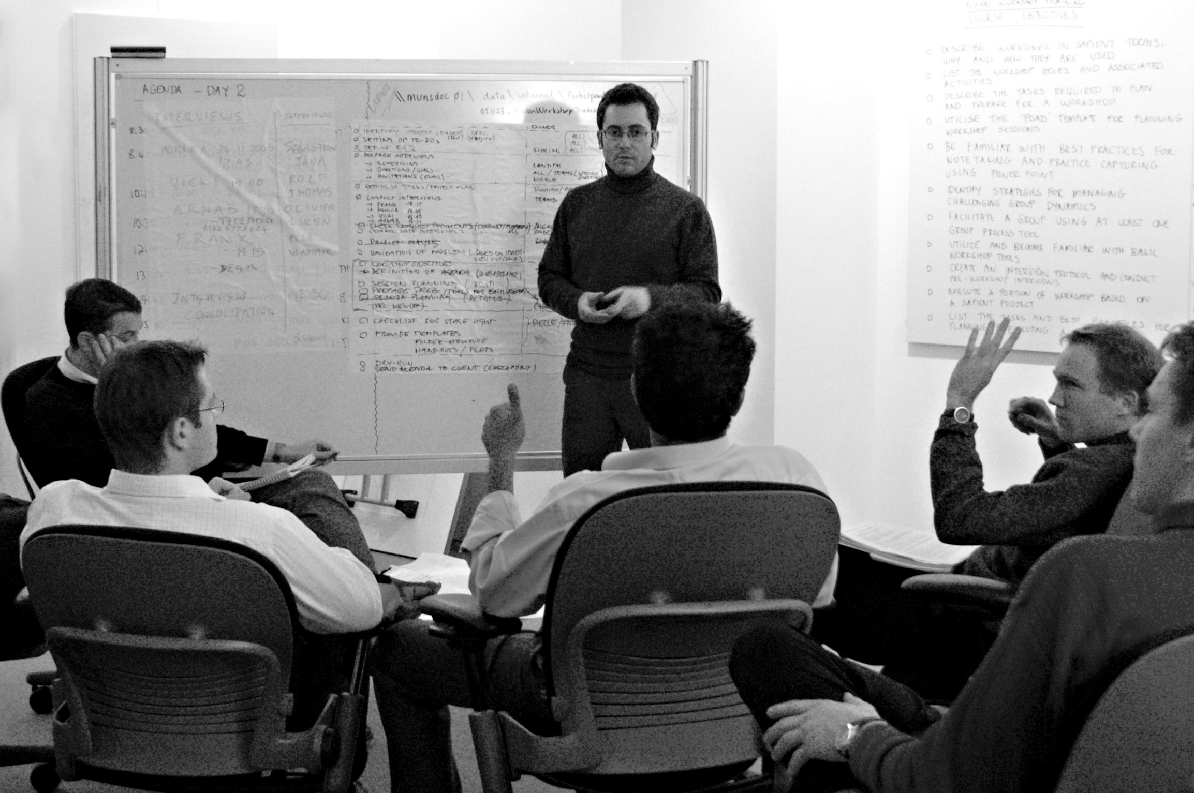
Class Exercise #5
Executing an iteration
I think this ok, maybe in first scenario add a creative lead?
Instructions (Total time required 120 min)
Split into 4 groups (minimim 3 per group)
Read the handout and the scenario details for your group
Prepare for the role play (10 min)
Role play (10 min per group)
Debrief (10 min per group)
Notes:
Speaker notes:
See Facilitation notes for details on how to facilitate this session.
Scenarios include:
Iteration kick-off
Change request discussion during an iteration close
Iteration close when the team did not reach the target

Slide 26
Key Takeaways
It is critical to set the client’s expectations on how S|A works at the start of the project
To effectively manage the team, invest the time upfront to ensure the team understands the processes and tools
Scope must be managed
At the “end of iteration” checkpoint, ensure that the client has the opportunity to try out what was built

Slide 27
Plan and execute a release

Slide 28
Execution – Running the delivery
PM activities
  Plan iterations
  Execute stories and tasks
  Track overall progress
  Drive iteration execution
  Drive iteration closure
  Manage communication
  Manage issues and risks
  Manage changes to scope
  Ensure audits and project reviews are happening
  Monitor quality
  Ensure that the tools are in place and are being used correctly
  Ensure Sapient|Approach is being used correctly and consistently
  Drive release closure
  others...
You will have to answer the following questions
  What will the focus for this release be?
  What stories will be included in this iteration?
  What are the key issues and risks? Are they being addressed adequately?
  Are there any roadblocks preventing progress?
  Is the project on track for this iteration and overall?
  Are we managing scope changes effectively?
  Is the quality of the project as it should be?
  Others…
** Red items will be covered in this section
Notes:
Speaker notes:
The mechanical steps for executing a release are similar to the EAR. The difference lies in the prioritisation and the nature of the stories….this is described on the next slide.

Slide 29
Plan and execute releases
Sapient|Approach
Fusion
Exec. Architecture Release
Release 2
Release 3
Manage
It 1
It 2
It 3
It 4
It 5
It 6
It 7
It 8
It 9
It 10
It 11
It 12
Go Live
Iteration N
Added points about usability testing (insted of UAT) for creative only projects, and shorter project durations for creative projx
Kick
off
Client team: acts as interface to client, does some dev work
GDD Team: develops and tests
Check
point
Project is broken into further releases
  Each release must be no more than 4 months in duration
  Each release must be planned (same process as for the EAR planning)
  UAT is required at the end of each release
  Release may be deployed to QA or production environment
Iterations are planned and executed
  Stories are prioritisated on business value
  Detailed requirements gathering, Analysis & Design, Coding and testing continue
  Fully tested, integrated, working software is available at the end of every iteration
Notes:
Speaker notes:
Things to call out:
Process for planning releases and iterations is mostly the same as for the EAR with the exception that story prioritisation is based on business value, whereas for the EAR story prioritisation was focused on risk
There is no separate “clean-up” phase
UAT at the end of each release should be planned for (even if it is only a release to the QA environment)
For Creative only projects it is recommended usability and/or prototype testing replaces UAT testing
Creative only projects are probably shorter in duration

Slide 30

Best practices for managing stories and tasks
Organise tracking around stories
  Move away from the mindset of only tracking at the task level
Focus on completing a couple of stories at a time
  Minimizes the work in progress, and the risk that you will have nothing to show the client at the end of the iteration
Account for task and story dependancies
Strategies for tracking story progress
  Use the whiteboard and stickies to monitor Not started stories, In progress stories, Completed stories
  Ensure that the team updates the Iteration Plan (i.e. ETC, passing of customer tests, story status, etc)
  If needed, create a LLP (i.e. when you have a junior team)
Notes:
Speaker notes:
The focus for today is on executing a Manage engagement.

Slide 31
Best practices for managing stories and tasks
Organise tracking around stories
  Move away from the mindset of only tracking at the task level
Focus on completing a couple of stories at a time
  Minimizes the work in progress, and the risk that you will have nothing to show the client at the end of the iteration
Account for task and story dependancies
Strategies for tracking story progress
  Use the whiteboard and stickies to monitor Not started stories, In progress stories, Completed stories
  Ensure that the team updates the Iteration Plan (i.e. ETC, passing of customer tests, story status, etc)
  If needed, create a LLP (i.e. when you have a junior team)
Notes:
Speaker notes:
The focus for today is on executing a Manage engagement.

Slide 32
Progress Reviews
Plan / Create / Manage
Fusion
Exec. Architecture Release (EAR)
Release 2
Manage
It 1
It 2
It 3
It 4
It 5
It 6
It 7
Progress
Review
Progress
Review
Progress
Review
CLEAR
Progress
Review
Progress
Review
Progress
Review
Progress
Review
A progress review is a type of review conducted by Sapient people outside of the project that focuses on reviewing project progress, and evaluating project risk
All projects above USD300K, are assigned a Review Owner who will gather a team and drive the review process with the PM
CLEAR (Collaborative Executable Architecture Review) is a type of review that happens prior to conclusion of the EAR with the purpose of determining if the EAR has been completed to an appropriate level of detail and quality in order to set the project up for successful delivery
Frequency:
  For Plan/Create projects, a Progress Review is required every 4 weeks
  For Manage projects a Progress Review must happen at the latest every 12 weeks
Overall goal of a Progress Review:
To evaluate the project risk.
Notes:
Speaker notes:
Ideally progress reviews should be planned for in the middle of each 4 week iteration. However if for some reason the iteration length is less than 4 weeks, that will not happen. Progress reviews do still need to happen every 4 weeks.
You can also mention that progress reviews are only tracked for projects that have a revenue of above USD300,000.
Review Owners are only Senior Managers and above, and it is up to them to pull together a team, based on a set of criteria that make sense for the project.
Progress review results are tracked in the review tracker that is created for each ResultSpace project.
For more information on progress reviews, go to the S|A site, click on Review > Progress Reviews. Click on artifacts tab, the open the S| Review Owner training for more details.

Slide 33
Audits
Plan / Create / Manage
Fusion
Exec. Architecture Release (EAR)
Release 2
Manage
It 1
It 2
It 3
It 4
It 5
It 6
It 7
Audit
Audit
Audit
Audit
Audit
Audit
Audit
Audit
Create
SAAP
Update
SAAP
Update
SAAP
An audit is a type of review conducted by a S|A Consultant that focuses on determining if the processes the team committed to, are being followed
All projects above USD300K are assigned a S|A Consultant who works with the project leadership to define the project S|A Adoption Plan (SAAP)
Frequency:
  For Plan/Create/Manage engagements an audit must happen every 4 weeks
  For QA Testing and Manage engagements running for more than 1 year, an audit must happen every 8 weeks
Overall goal of an Audit:
To make sure teams are using S|A in a consistent manner while at the same time learn how processes can be improved.
Notes:
The standard frequency is every 4 weeks, however if a project has consistently shown a high level of compliance, the frequency can be decreased to every 6 weeks. However if a project has consistently shown a low level of compliance, the frequency will be increased.

Slide 34
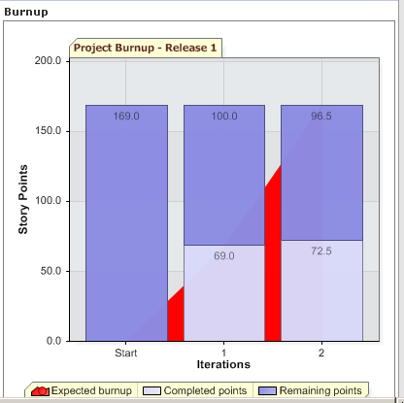
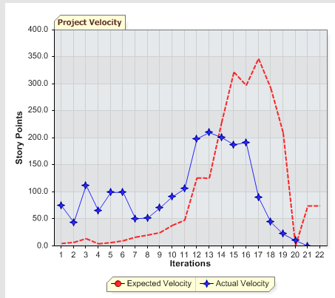
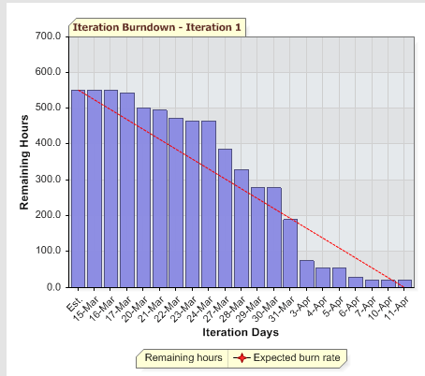
How do I measure progress?
Project Burnup
Velocity
Iteration Burndown
Is the project on track?
Project burnup compares expected with completed story points
Expected burnup
  Measures accumulated expected story points
  Derived from the Staffing Plan and can be proportionately configured (Eg to take into account ramp up for Iteration 1)
Completed points
  Measures the actual total number of story points completed for the project
What is the team productivity?
Velocity compares expected and actual velocity from one iteration to the next
Expected velocity
  Measures expected story points per iteration
  Derived from the staffing plan (which takes into consideration total LOE)
  Can be proportionately configured (Eg to take into account ramp up in Iteration 1)
Actual velocity
  Measures the number of actual story points completed per iteration
Are we on track this iteration?
Iteration burndown compares expected with actual remaining hours
Expected burndown
  Measures total expected hours per day
  Linear value derived from initial number of remaining ETC (hours)
Remaining hours
  Derived from the sum of ETCs for the stories in this iteration
NOTE: These charts are only useful if the team updates the Plan Tool!!
Notes:
Speaker notes:
Key message: These graphs are to be used in conjunction with daily team meetings, track lead meetings etc. They do not replace all the other communication mechanisms that we have in place, however they are a useful means of finding a data driven mechanism to track real progress.
Call out the questions that these graphs address.
If teams update the story status in the iteration plan on a daily basis can these graphs be used.
Question for the group: How can you make sure your team updates the RS iteration plan?
Sample answer: update the iteration plan during and as part of the daily team meeting.
More info on how certain values are calculated:
This is how the plan tool calculates the expected velocity.
Expected Velocity (Iteration I) = Velocity Prediction Percentage(EVI) + Buffer Velocity + Velocity for Increased scope
Where EVI = relative staffing for Iteration I X (sum of ABPs of stories assigned to Iteration I)
Relative Staffing = Staffing for Iteration I / sum of staffing for all iterations of Release
Buffer Velocity = If we opt for 50-75-100+ model for Velocity Prediction, for first three iterations some velocity gets left, which comprises up for buffer velocity. If you are not working 100% in early phases of your release you will have to compensate for it in later stages.
Velocity for increased scope = If stories got added in between the iterations on release, the scope is taken into consideration for the present iteration and the Iterations coming afterwards. i.e. (Relative staffing for I) * (sum of ABPs of stories added in increased scope)
Iteration Burndown:
(1) Red line
=> the value of the red line is calculated from the staffing plan (this is new...it used to be a straight line from the Est regardless of staffing)
Eg if you have a team staffed as follows: 0 0 0 0 2 2
If you look at the values of the red line for that week, it starts off with the total number of values avail that iteration which is (2*5 + 2*5)*8 = 160 hours
The first 4 weeks, there is noone staffed and the value stays at 160. Then in week 5 you will see the value starts to decline go down to reflect people being staffed.
(2) Est value (left bar on the graph)
=> This is the sum of the ABP for each story. This in effect shows you when an iteration is overstaffed or buffer has been planned (which is the case for us).
(3) Remaining hours
=> Remaining hours = the total of the ETCs for each story that has been tasked our + the ABP of the stories that have not been tasked out

Slide 35
Class Exercise #6
Measuring progress
Instructions (Total time required 60 min)
Split into 4 teams
Read the case study and review the progress charts assigned to your group. Describe the current state of the project and define strategies to keep the project moving forward. (20 min)
Present your results (10 min per group)
Notes:
Speaker notes:
Give handouts to the participants, and see Facilitation notes for details on how to facilitate this session.

Slide 36
Key Takeaways
While the progress charts provide an excellent mechanism to measure progress, they must be used in conjunction with other communication channels
The progress charts only provide insight into the status of the project if the team updates the tools

Slide 37
Execute a Manage engagement

Slide 38
Execute a Manage engagement
PM activities
  Support SLA creation
  Plan the engagement
  Define the team structure
  Staff the team
  Manage defects
  Monitor SLA performance and responsiveness requirements
  Manage enhancements
  Plan and execute iterations
  Plan and execute releases
  Track overall progress
  Manage issues and risks
  Manage change requests
  Ensure audits and project reviews are happening
  Monitor quality
  Ensure that the tools are in place and are being used correctly
  Ensure Sapient|Approach is being used correctly and consistently
  others...
You will have to answer the following questions
  What will the focus for this release be?
  What stories will be included in this iteration?
  What are the key issues and risks? Are they being addressed adequately?
  Are there any roadblocks preventing progress?
  Is the project on track for this iteration and overall?
  Are we managing scope changes effectively?
  Is the quality of the project as it should be?
  Others…
** Red items will be covered in this section
Notes:
Speaker notes:
The focus for today is on executing a Manage engagement.

Slide 39
Scope of Sapient Manage services
Level 1 Help Desk
User Queries, Operation/Business Support
Infrastructure Management
Physical Hardware, Network Operations and Environments
Level 2 – Production Support
Incident Triaging, Problem Tracking/Routing and Resolution Coordination
Infrastructure Security
Security, Intrusion Detection
Level 3 – Ongoing Maintenance
Bug Fixes, Upgrades, Capacity Planning, Documentation
Program Management
Change Management, Release Planning and Communication
Third Party Support
Packaged Software
Functional Testing
Regression Testing
Performance Testing
Free-form Testing
Compatibility Testing
(Browser, OS)
Quality Assurance
Testing Management, Test Automation and Testing Support
Business Processes
Content, Data Updates
Enhancements
Application Evolution
Outsourcing Opportunity for the client
High
Medium
Low
Notes:
Speaker notes:
The focus for today is on Production Support and Enhancements. We will not cover Testing or QA engagements.

Slide 40
Manage Life Cycle
Contracting
2-3 weeks
Inception
Define desired business results
Identify scope of services
Develop SLAs
Agree on roles & responsibilities
Agree on engagement model and pricing
2-3 weeks
Transition
Staff team
Set up project management processes
Develop risk mitigation plans
Define detailed support processes
4-8 weeks
Execution
Knowledge transfer
Implement processes
Capture metrics
Implement reports
Iterate on management model
Ongoing
Multiple year engagements
Update model as required
Continue to support & maintain current operations
Client location
India
Notes:
Speaker notes:
For an engagement where we have also owned the Create component, the contracting and inception phases will overlap the end of the project.
The transition phase will happen once the project goes live. The focus for the rest of this training is on the execution piece.

Slide 41
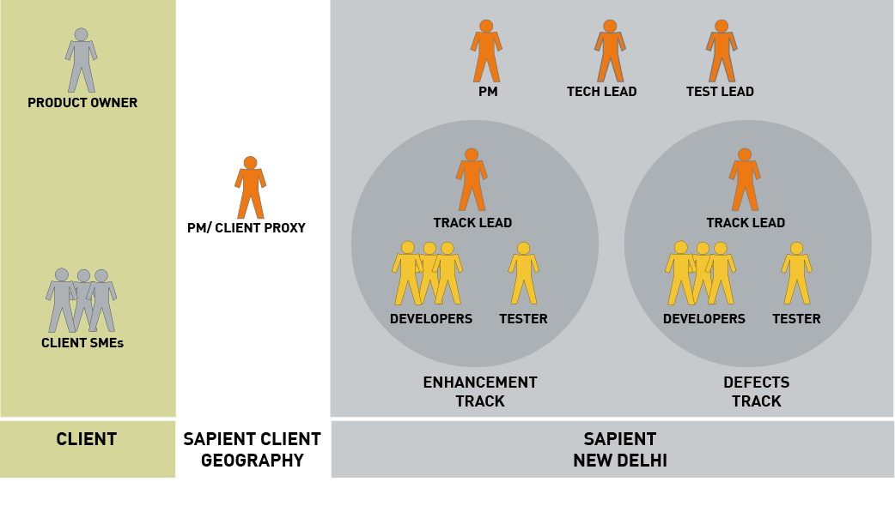
Manage team structure example
Notes:
Speaker notes:
Mention that there are several models proposed to clients
PM and team at Sapient local geography in addition to the India team
No local PM, instead a part-time CE. The India team works directly with the client
The model illustrated in this slide…Local PM/client proxy, and the rest of the team in India
Also mention that this is an example structure. There are many permutations and combinations of this depending on what services were sold, team size etc.

Slide 42
Executing a Manage engagement as separate projects
Defects
Release 4
Release 5
Release 6
Release 7
1 week
It 1
It 2
It 3
It 4
It 5
It 6
It 7
It 8
It 9
It 10
It 11
It 12
Support releases
Manage defects
Typically 1 week iterations (incl checkpoints with client)
Unplanned and planned releases to production environment
Weekly or monthly planned releases to production (every 4 months at the latest)
Enhancements
Release 4
Release 5
2 weeks
It 1
It 2
It 3
It 4
It 5
It 6
Enhancement
releases
Manage enhancements
1-4 week iterations
Releases to production or QA environment at the end of every release (every 4 months at the latest)
Notes:
Speaker notes:
Many of our manage engagements have production support and enhancements.
One way to address this is to treat them as 2 separate projects from a planning and tracking perspective.

Slide 43
Executing a Manage engagement as one project
Defects and Enhancements
Release 4
Release 5
2 weeks
It 1
It 2
It 3
It 4
It 5
It 6
Support releases
Enhancement
releases
Combined defects and enhancements management
1-4 week iterations (as dictated by the Enhancements needs)
2 types of releases
  (1) Support release (planned and unplanned)
  (2) Enhancement release
Support releases to production for high priority defects occur as needed and may or may not coincide with Enhancement releases
Enhancement release to production or QA environment must occur every 4 months at the latest
Notes:
Speaker notes:
Often defect and enhancement work is managed and tracked as 1 project.
In this case you would set up the tool to support the releases, iterations as decribed abovel.

Slide 44
Using the Plan Tool for a Manage engagement
Enhancements
Defects
Story
Option 1a: Story
Option 1b: Story tasks
Option 2: TAR Tracker
Iteration Plan
Iteration Plan
Iteration Plan
TAR Tracker
KICKOFF
1 Story
CHECKPOINT
KICKOFF
1 Story
CHECKPOINT
KICKOFF
1 Story
CHECKPOINT
1 TAR
2 Story
Enhance-
ment
2 Story
Defect
Task
2 TAR
Defect
3 Story
3 Story
Task
Defect
3 TAR
4 Story
4 Story
Task
4 TAR
5 Story
5 Story
2 Story
5 TAR
6 Story
6 Story
Task
6 TAR
7 Story
Task
8 Story
3 Story
9 Story
Task
10 Story
Task
11 Story
Task
Each enhancement is managed as a story
Some enhancements may originally be logged as CRs. These must be converted to stories
Each defect is managed as a story
Small defects can be grouped into 1 story using story tasks
Each defect is managed as a TAR tracker item
Notes:
Speaker notes:
Once the releases and iterations have been set up in the ResultSpace Plan tool, the team must decide on the approach to manage the defects.
Enhancements are managed as regular stories. However for defects there are several options. It is possible to use a combination of option 1 and 2. However if you go with option 3, then it is not recommended to define defects as stories.
Note that often enhancements arise in the form of Change Requests. As described in the change request process, once these CRs are approved, these must be created as stories.
The downside of this is that when defects are tracked as TARs, and enhancements as stories, there is no way of getting an overview of what is included in a release package.

Slide 45
Common pitfalls and stories from the field
Notes:
Speaker notes:
Video with various people who have used S|A including one person from a Create project, and one person from a Manage engagement.

Slide 46
Common pitfalls
Planning paralysis
  Getting stuck in planning mode at the start of each iteration, and not getting to the actual work
Lack of discipline
  Not updating the plan
  Claiming incomplete stories are complete
Not setting client expectations
  What to expect in early iterations
  Involvement each iteration
Iterative death spiral
  Iterating instead of doing incremental development
Scope changes in the middle of an iteration
  Not managing scope change requests in the middle of an iteration
Not doing core design work
  Not creating core design artifacts
Not accounting for design rounds and/or rework in story estimation
  Effort and time for refactoring/rework not accounted for and planned
Creative track bottleneck
  Development team insists on detailed documentation from creative track to begin working
Insufficient communication or established working rules between creative and development
  Miscommunications/understandings about design solutions lead to demands for detailed documentation
Testing undervalued
  Not automating tests
  Not doing testing throughout the project
Not using the tools
  Not using ResultSpace for planning and tracking
Added some lessons learned
Notes:
Speaker notes:
The focus for today is on executing a Manage engagement.

Slide 47
Thank You!

